Slide 1
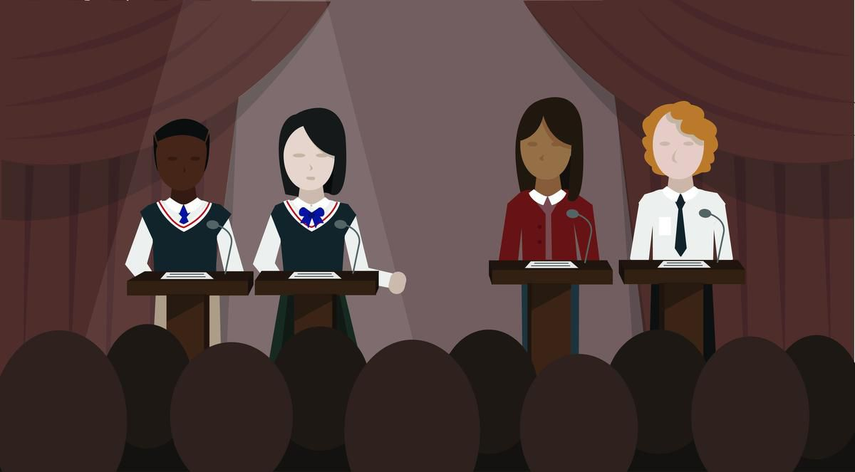
SPOntaneous ARGumentation (SPAR)
purposes applying material, quick thinking, developing arguments, asking questions, listening; persuading, having fun
elements topic or proposition, affirmative team, negative team, judging team
affirmative team argues in favor of the proposition
negative team argues against the proposition
judging team listens to the debate, deliberates, selects a winner, and explains selection
instructor provides topic, keeps time, and guides closing discussion
Image source: Toronto Star

Slide 2
SPontaneous Argumentation
Topic is announced 1 minute
Teams meet in separate breakout rooms to prepare* 10 minutes
Affirmative team makes opening statement 2-3 minutes
Negative team cross-examines affirmative team 2-3 minutes
Negative team makes opening statement 2-3 minutes
Affirmative team cross-examines negative team 2-3 minutes
Affirmative team makes closing statement 2-3 minutes
Negative team makes closing statement 2-3 minutes
Deliberation by judging team 10 minutes
Judges announce winning team and explain decision 2-3 minutes
Class discussion about debate 10 minutes
*—teams will choose their spokespersons during this time
Times and format can be adjusted based on class duration (50 v. 75 minutes) and personal preference (e.g., eliminate cross examinations, provide more time for preparation or discussion)

Slide 3
Example SPAR session Proposition: Droids are sentient beings and should have rights.
2:30-2:40 affirmative, negative, and judging teams will meet in different breakout rooms
2:40-2:43 everyone comes back together; affirmative team makes opening argument
2:43-2:46 negative team cross-examines affirmative team
2:46-2:49 negative team makes opening statement
2:49-2:52 affirmative team cross-examines negative team
2:52-2:55 affirmative team makes closing statement
2:58-2:58 negative team makes closing statement
2:58-3:08 judges meet to deliberate and vote for winner
3:08 -3:11 judges announce and explain decision; prize awarded
3:11-3:20 class discussion about debate
Please remember to be respectful.
Personal attacks are inappropriate and ineffective.

